Slide 1
Chapter 31
Computer-Aided Software Engineering

Slide 2
CASE
... in its idealized form, CASE combines a set of
software development tools that are
integrated
with a
data base to form an environment...
... the tools address each important step in the
software engineering process ...
... the tools increase insight thereby improving quality;
reduce drudgery thereby improving productivity; and
enhance control, thereby leading to on-time projects ...

Slide 3
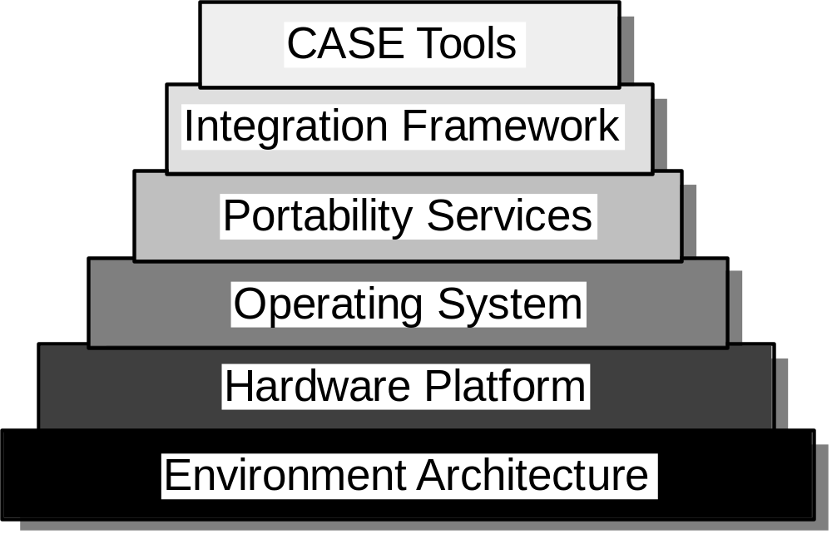
CASE Environment Model

Slide 4
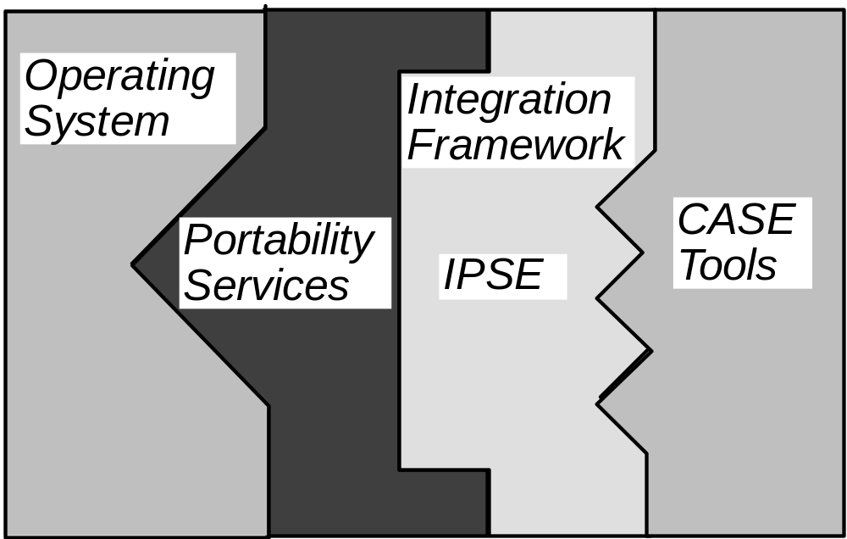
The Challenge: Putting it Together

Slide 5
An Integration Framework
user interface layer
interface tool kit
presentation protocol
tools management services
CASE
tools layer
tool
object management layer
integration services
configuration management services
shared repository layer
CASE database
access control functions

Slide 6
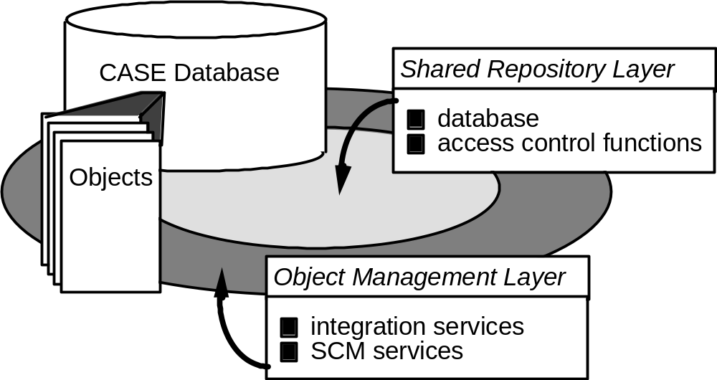
Data Integration:
The CASE Repository

Slide 7
A Taxonomy of CASE Tools
business systems planning
project management
support
CASE
analysis and design
Database
programming
integration &testing
prototyping/simulation tools
re–engineering
framework

